Slide 1


ETHICAL DECISION MAKING IN SPORT
Workshop
Notes:
Welcome,
Intro me
Session overview handout
Proposed outcomes
Intro from participants
Q - What you want out of the session?

Slide 2
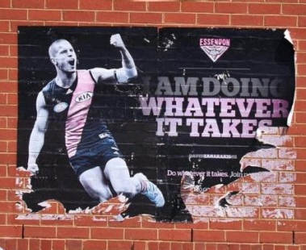
The purpose of sport for many is to win, but we need to reinforce that the manner in which this objective is achieved is also very important.
Notes:
In a fast changing, ever-evolving sporting environment, sport is being bombarded by unprecedented challenges from many directions, whether it be performance and image enhancing drugs, match fixing, results manipulation, the increased use of supplements or day-to-day issues around governance, fair play or discrimination.
I understand that the purpose of sport for many is to win, particularly at the sub-elite and elite levels. What we aim to do is reinforce the manner in which this objective is achieved is also very important.
The goal of this forum is to increase your awareness of integrity issues in sport and deepen the discussion with you on ethical conduct, personal responsibilities and decision making around these issues.

Slide 3
TODAY’s WORKSHOP – content & objectives
Discuss current issues & protections in sport.
Talk about choices & consequences.
Debate the meaning and value of sport.
Learn out about integrity & culture in sport.
Discover ethics and ethical decision making.
Introduce a simple, effective ethical decision making framework.
Try it out on some tricky dilemmas and make you feel comfortable using it.
Point you to further resources & contacts.
Notes:
An intro to ethical decision-making in sport.
Talk about choices, consequences, integrity, values, purpose and morals.
Introduce a simple, effective framework that can be used to guide you on ethical dilemmas.
Teach you ethical decision-making skills and then practice these on tricky dilemmas.
No right or wrong
We want your participation
Be respectful of other’s views

Slide 4
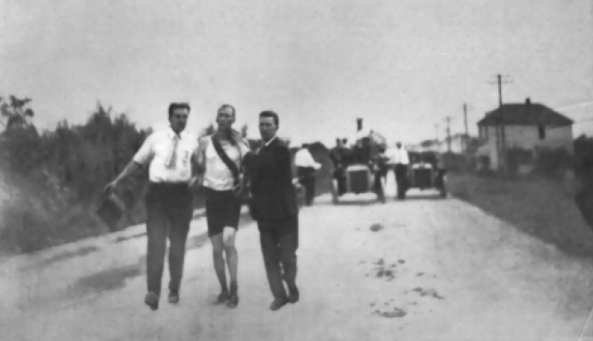
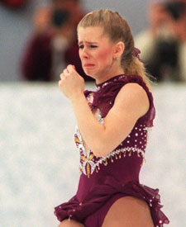
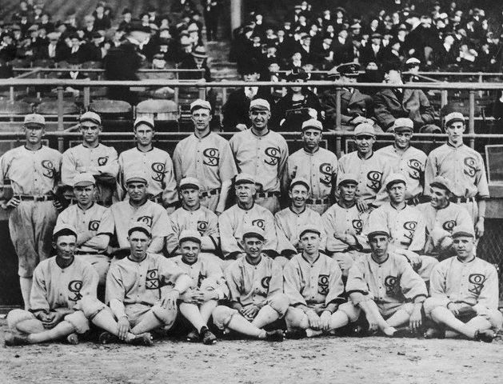
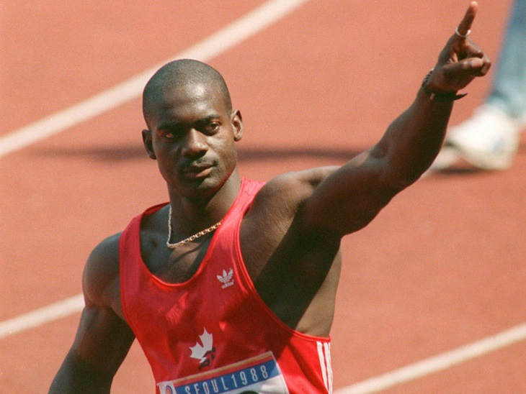
Tonya Harding, a former U.S. national skating champion who was banned for life following an assault involving fellow skater Nancy Kerrigan.
Thomas Hicks, who won the marathon at the 1904 Summer Olympics after having received several doses of strychnine sulfate mixed with brandy from his trainers.
Disgraced drug cheat - Canadian sprinter Ben Johnson.
Eight members of the Chicago White Sox were allegedly bribed by gamblers to throw the 1919 World Series.
Notes:
The first to arrive at the finish line was Frederick Lorz, who actually was just trotting back to the finish line to retrieve his clothes, after dropping out after nine miles. When the officials thought he had won the race, Lorz played along with his practical joke until he was found out shortly after the medal ceremony and was banned for a year by the AAU for this stunt Thomas Hicks (a Briton running for the United States) was the first to cross the finish-line legally, after having received several doses of strychnine sulfate mixed with brandy from his trainers. He was supported by his trainers when he crossed the finish, but is still considered the winner. Hicks had to be carried off the track, and possibly would have died in the stadium, had he not been treated by several doctors. A Cuban postman named Felix Carbajal joined the marathon, arriving at the last minute. He had to run in street clothes that he cut around the legs to make them look like shorts. He stopped off in an orchard en route to have a snack on some apples, which turned out to be rotten. The rotten apples caused him to have to lie down and take a nap. Despite falling ill to apples he finished in fourth place. Also, a runner finished half of the Marathon driving an automobile.
Eight players from the Chicago White Sox were allegedly bribed by gamblers to throw the 1919 World Series to the Cincinnati Reds. The eight implicated players, among them the great "Shoeless" Joe Jackson, were later acquitted on criminal charges. They were, however, banned from baseball for life.
In the past, riders have scattered broken glass and fans have tossed nails on the road to confound rivals. In the 1960s, riders attempted to gain a competitive edge with amphetamines and alcohol. In doing so, Britain's Tim Simpson lost his life during the 1967 Tour.
On April. 21, 1980, the 23-year-old Ruiz was the first woman to cross the finish line at the Boston Marathon. She did it in the third-fastest time ever recorded for a female runner (two hours, 31 minutes, 56 seconds). Eventually a few spectators came forward and said they saw Ruiz join the race during its final half-mile. It seems that she had sprinted to the finish line
Johnson captured the imagination of Canadians on Sept. 27, 1988, when he won the 100-metre sprint title in a world-record time of 9.79 seconds at the Seoul Olympics. To make the victory even sweeter, Johnson captured the gold medal by handily defeating American rival Carl Lewis.
The euphoria of Johnson's win didn't last, however, when it was found the Canadian tested positive for the anabolic steroid stanozolol.
Harding, a former U.S. national skating champion, was in a heated battle with Kerrigan for the U.S. title in January of 1994. The competition was touted as a preview of the gold-medal battle at the Lillehammer Olympics one month later. But during practice for the championships, Kerrigan was clubbed in the leg and injured by a mysterious assailant. Harding went on to win the competition, but soon found herself in the middle of a criminal investigation into the attack on Kerrigan.

Slide 5


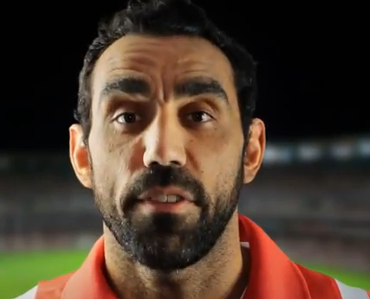

Notes:
Sport is the great paradox – it’s the the sinner and the saviour (depending on who you speak to).
Why – it’s life under a microscope with every social issue (good and bad) thrown in with the competition element and human nature and parents and their kids all mixed together.
Coaches and officials live it, players will do whatever it takes to win, spectators support is fanatical.
No one escapes its passionate pull - which inevitably brings out the best and worst in everyone involved.
Is it any wonder we have the range of integrity and corruption issues (poor parent and spectator behaviour, bullying, abuse and violence, discrimination and exclusion issues that we currently have in sport.

Slide 6

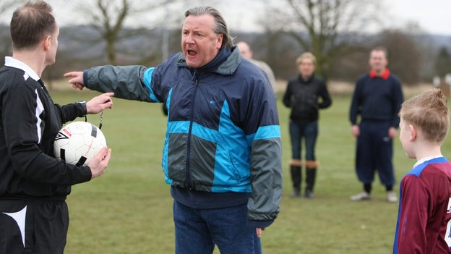
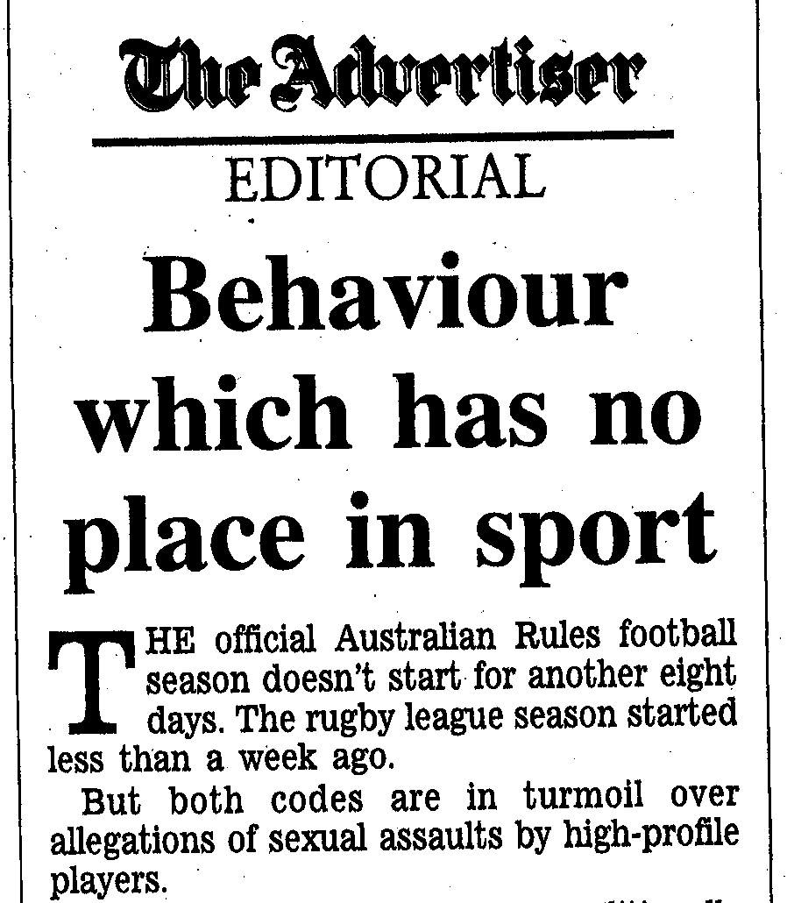

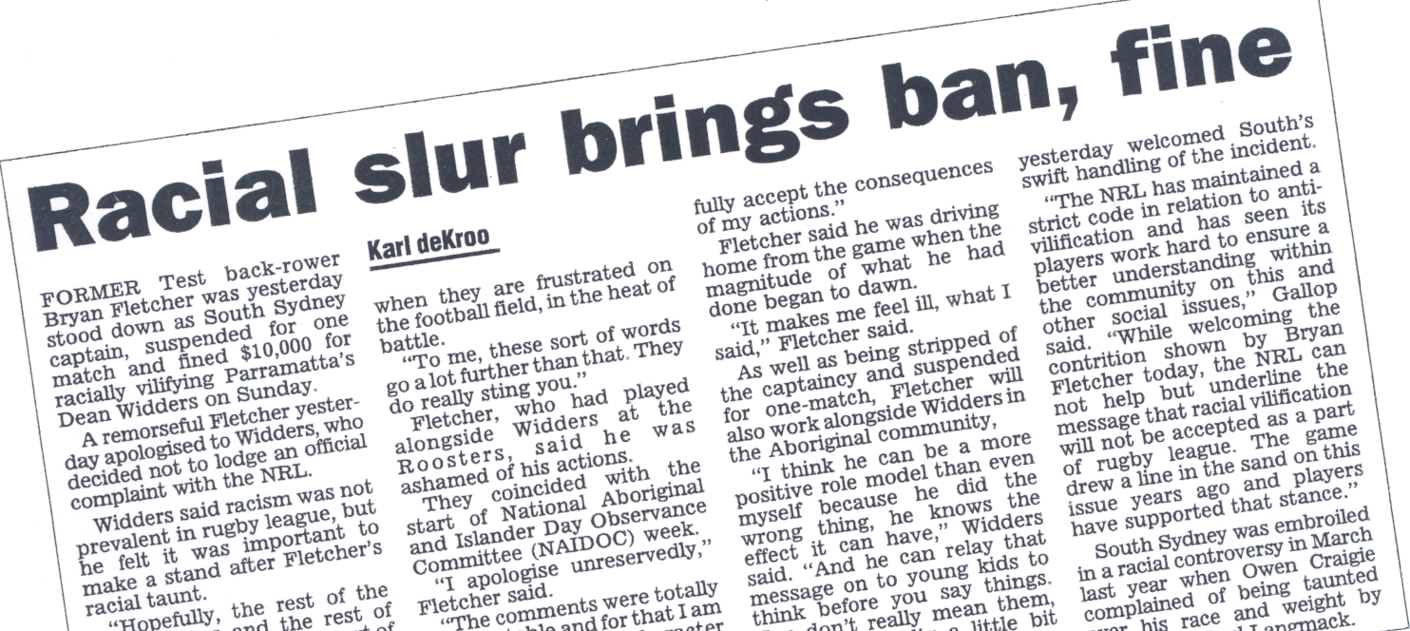
Notes:
Sport is the great paradox – it’s the the sinner and the saviour (depending on who you speak to).
Why – it’s life under a microscope with every social issue (good and bad) thrown in with the competition element and human nature and parents and their kids all mixed together.
Coaches and officials live it, players will do whatever it takes to win, spectators support is fanatical.
No one escapes its passionate pull - which inevitably brings out the best and worst in everyone involved.
Is it any wonder we have the range of integrity and corruption issues (poor parent and spectator behaviour, bullying, abuse and violence, discrimination and exclusion issues that we currently have in sport.

Slide 7

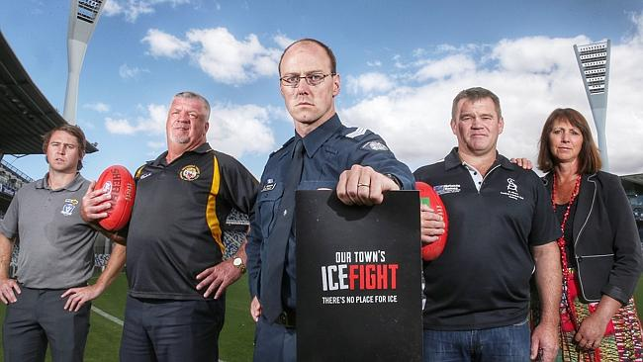
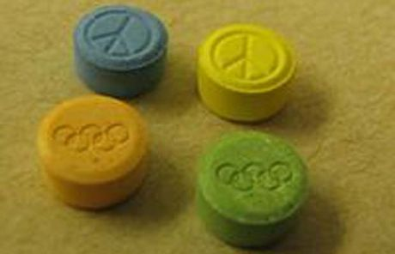
Notes:
Sport is the great paradox – it’s the the sinner and the saviour (depending on who you speak to).
Why – it’s life under a microscope with every social issue (good and bad) thrown in with the competition element and human nature and parents and their kids all mixed together.
Coaches and officials live it, players will do whatever it takes to win, spectators support is fanatical.
No one escapes its passionate pull - which inevitably brings out the best and worst in everyone involved.
Is it any wonder we have the range of integrity and corruption issues (poor parent and spectator behaviour, bullying, abuse and violence, discrimination and exclusion issues that we currently have in sport.

Slide 8

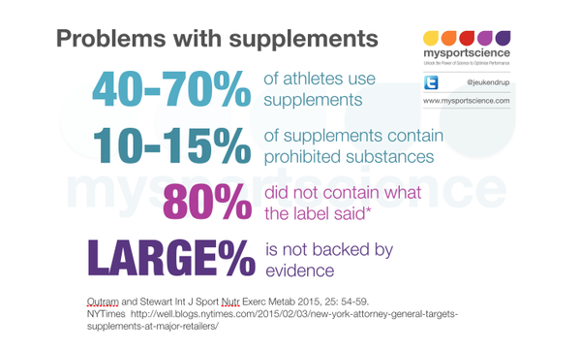
Notes:
Sport is the great paradox – it’s the the sinner and the saviour (depending on who you speak to).
Why – it’s life under a microscope with every social issue (good and bad) thrown in with the competition element and human nature and parents and their kids all mixed together.
Coaches and officials live it, players will do whatever it takes to win, spectators support is fanatical.
No one escapes its passionate pull - which inevitably brings out the best and worst in everyone involved.
Is it any wonder we have the range of integrity and corruption issues (poor parent and spectator behaviour, bullying, abuse and violence, discrimination and exclusion issues that we currently have in sport.

Slide 9




Notes:
We have a range of laws, rules, policies and good governance principles in place
Codes of conduct and behaviour for sporting organisations and their participants
Complaints processes, investigations and tribunals
Sport integrity units and monitoring
Penalties, sanctions and bans for those who transgress.
We have education and training on the rules, monitoring, testing, investigations and sanctions to deter people from poor choices and the risks and consequences of those choices.
But still people transgress and still integrity issues abound. For some, the risks are always worth the rewards and human nature makes us fallible.

Slide 10

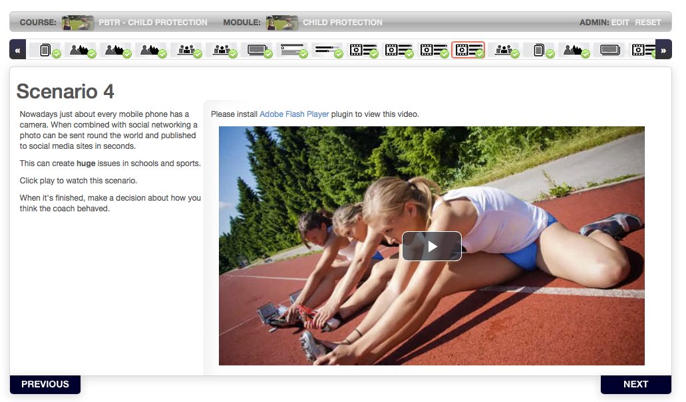

Notes:
We have a range of laws, codes, policies and good governance principles in place.

Slide 11
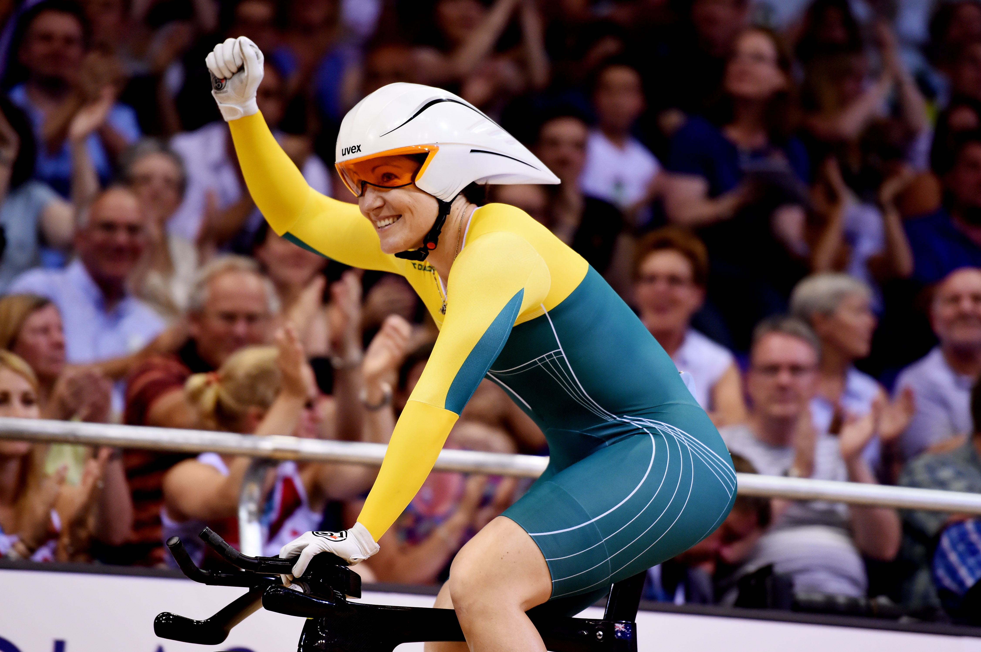
"We all have choices, we all have decisions to make and whichever choice you make will have ramifications - positive or negative.
If you're prepared to make decisions that are incorrect or bad, then you need to be prepared to take the repercussions that come from that.”
World Champion cyclist Anna Meares

Slide 12
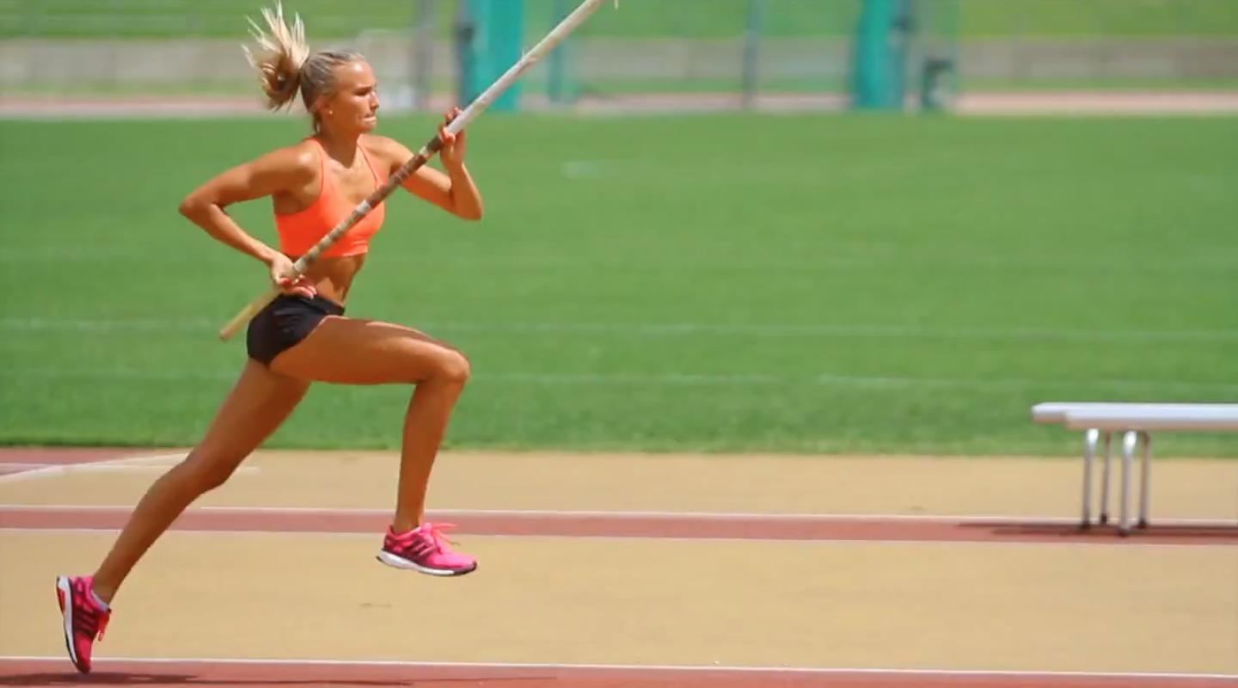
https://youtu.be/-gv5z1LGrbM (Play all of the video)

Slide 13
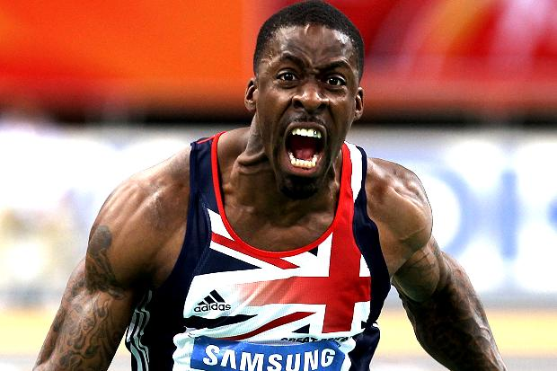
Britain’s former world 100m bronze
medallist Dwain Chambers on doping:
“I never realised the magnitude of the mistake or the disruption it would cause . . . If I could have looked in a crystal ball and seen what happened, I'd never have made that decision. Life is a long motorway. I chose an exit that didn't work for me. If I drove that same road again, I'd read the description on all the signs. I'd choose a different exit."

Slide 14


SOCIAL: HEALTH:
Damages relationships - High blood pressure
Decrease career prospects - Hypertension
Wipe out previous success - risk of heart attack
Isolation from peers - liver disease
Negative image - depression/ anxiety
Loss of trust and respect - addiction

Slide 15
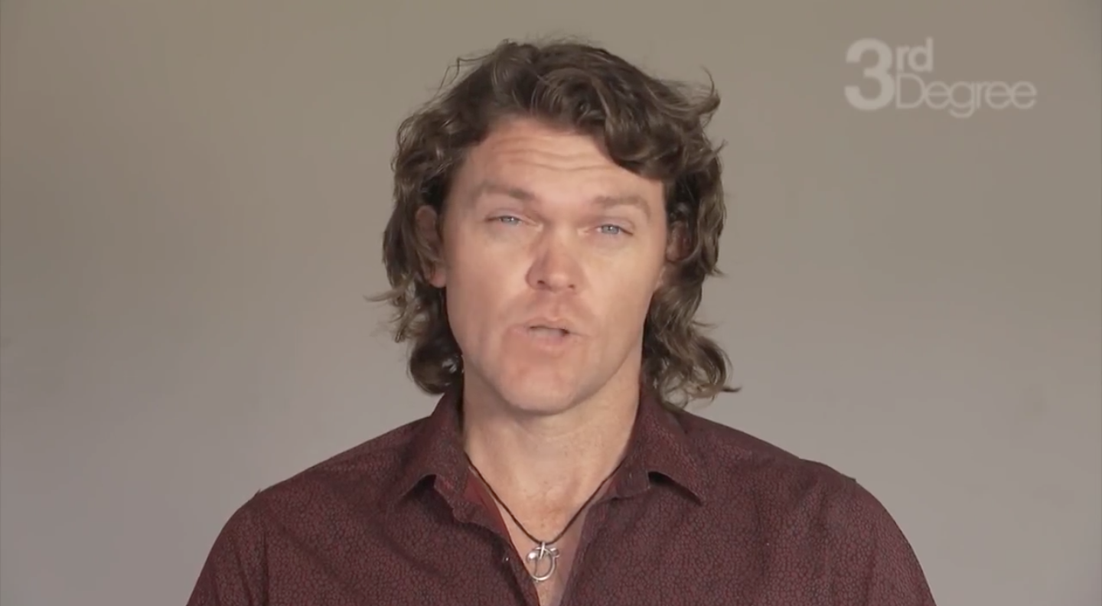
https://www.youtube.com/watch?v=RnSilRHdTTE (play 0:00-1:06)
Notes:
The pressure to succeed at younger ages from parents, coaches, clubs and a seriously unhealthy fear of failure or missing out is resulting in a win at all costs, no risk no reward, whatever it takes attitude that has enveloped modern sport at all levels and has led to recent integrity issues.

Slide 16

How can we make sure people are equipped to get it right and not just avoid getting it wrong?

Slide 17
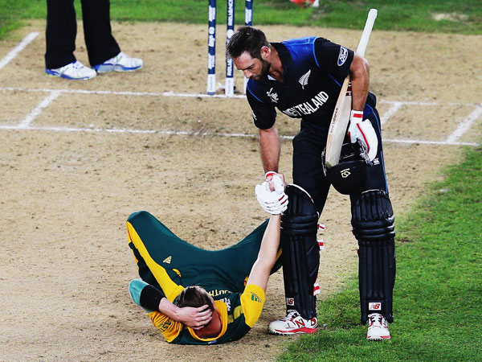
What is the meaning of sport to you?
Notes:
If somebody cheats, bullies, discriminates, abuses then there is no doubt that they should be held accountable to the rules and codes of a sport, but an effective approach needs more than rules and penalties.
One of the first steps to engaging athletes, coaches and administrators in the decision making process on issues is to understand their attitudes on what sport means to them, why they participate and how they consider values such as fair play, honesty and sportsmanship and what importance they give to integrity in sport - as this offers the strongest anchor on attitudes and subsequently, behavioural choices.

Slide 18

Notes:
If somebody cheats, bullies, discriminates, abuses then there is no doubt that they should be held accountable to the rules and codes of a sport, but an effective approach needs more than rules and penalties.
One of the first steps to engaging athletes, coaches and administrators in the decision making process on issues is to understand their attitudes on what sport means to them, why they participate and how they consider values such as fair play, honesty and sportsmanship and what importance they give to integrity in sport - as this offers the strongest anchor on attitudes and subsequently, behavioural choices.

Slide 19

Notes:
So what is integrity?
Integrity at a personal level is a ‘form of self consciousness’ and involves ‘taking responsibility for our moral decisions’. Acting with integrity is described as when your’ outer actions reflect your inner values and beliefs’.
Integrity in sport is associated with concepts of fair play, respect for the game, sportsmanship, responsibility, accountability, and honesty in adhering to rules.
Why does it matter?
Poor integrity can result in a lack of belief and support for sport by participants and the wider public.
Safeguarding the integrity of sport is about protecting the reputation and sustainability of sport itself.

Slide 20
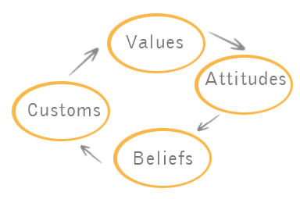
CULTURE
Notes:
While stronger laws, good governance, codes of conduct and sanctions are powerful guides and deterrents – they are only half the equation. In sport, where performance, ethics, values, principles and morals collide on a regular basis, making the right decision is not always straightforward.
That’s why we need to have a more thorough discussion with athletes, coaches and administrators, on the questions of what we each value, what we believe is good and bad or right and wrong, and how we bring our individual moral codes to bear in our choices, especially the tricky ones.
So how can people live and perform in a way where they are ‘true’ to themselves and their sport? How can we encourage a shift in the conversation back to thinking about why these integrity issues are a problem in the first place, what the price is if we seek to win at all costs and why the concept of ‘fair sport’ ought to be protected.
We can find out the answer to these questions by looking deeper at what ethics is and what being ethical means.

Slide 21

Notes:
While stronger laws, good governance, codes of conduct and sanctions are powerful guides and deterrents – they are only half the equation. In sport, where performance, ethics, values, principles and morals collide on a regular basis, making the right decision is not always straightforward.
That’s why we need to have a more thorough discussion with athletes, coaches and administrators, on the questions of what we each value, what we believe is good and bad or right and wrong, and how we bring our individual moral codes to bear in our choices, especially the tricky ones.
So how can people live and perform in a way where they are ‘true’ to themselves and their sport? How can we encourage a shift in the conversation back to thinking about why these integrity issues are a problem in the first place, what the price is if we seek to win at all costs and why the concept of ‘fair sport’ ought to be protected.
We can find out the answer to these questions by looking deeper at what ethics is and what being ethical means.

Slide 22
ETHICAL STANDARDS
Utilitarianism or Consequentialism (ethics of consequences) - decisions are made based on the consequences for others’ wellbeing.
Deontology (ethics of principles) - decisions should be a matter of principle, not consequences, and should follow rules.
Virtue ethics (ethics of personal character) - one should act in accordance with the virtues of a good person as an ethical life carries its own rewards.
Notes:
While stronger laws, good governance, codes of conduct and sanctions are powerful guides and deterrents – they are only half the equation. In sport, where performance, ethics, values, principles and morals collide on a regular basis, making the right decision is not always straightforward.
That’s why we need to have a more thorough discussion with athletes, coaches and administrators, on the questions of what we each value, what we believe is good and bad or right and wrong, and how we bring our individual moral codes to bear in our choices, especially the tricky ones.
So how can people live and perform in a way where they are ‘true’ to themselves and their sport? How can we encourage a shift in the conversation back to thinking about why these integrity issues are a problem in the first place, what the price is if we seek to win at all costs and why the concept of ‘fair sport’ ought to be protected.
We can find out the answer to these questions by looking deeper at what ethics is and what being ethical means.

Slide 23

https://vimeo.com/48525864 - (Play 0-1:13)
Notes:
Ethics guides the behaviours and choices we make and incorporates rules, principles, values and purpose.
Being ethical is not always a clear choice between right and wrong (it may be two rights, two wrongs).
Judging a decision as unethical or lacking in integrity is not usually as straightforward as whether someone has made a clear trade of between cheating and winning.
How we perceive what the best or good choices are, are usually based on our values.
Common VALUES are honesty, respect, fairness, compassion, responsibility. Other values also seen as important in sport are courage, trust, honour, commitment.

Slide 24
VALUES
Accountability, Accuracy, Achievement, Adventurousness, Altruism Ambition, Assertiveness, Balance, Being the best, Belonging, Boldness, Calmness, Carefulness, Challenge, Cheerfulness, Clear-mindedness, Commitment, Community, Compassion, Competitiveness, Consistency, Contentment, Continuous Improvement, Contribution, Control, Cooperation, Correctness, Courtesy, Creativity, Curiosity, Decisiveness, Democraticness, Dependability, Determination, Devoutness, Diligence, Discipline, Discretion, Diversity, Dynamism, Economy, Effectiveness, Efficiency, Elegance, Empathy, Enjoyment, Enthusiasm, Equality, Excellence, Excitement, Expertise, Exploration, Expressiveness, Fairness, Faith, Family-orientedness, Fidelity, Fitness, Fluency, Focus, Freedom, Fun, Generosity, Goodness, Grace, Growth, Happiness, Hard Work, Health, Helping Society, Holiness, Honesty, Honor, Humility, Independence, Ingenuity, Inner Harmony, Inquisitiveness, Insightfulness, Intelligence, Intellectual Status, Intuition, Joy, Justice, Leadership, Legacy, Love, Loyalty, Making a difference, Mastery, Merit, Obedience, Openness, Order, Originality, Patriotic, Perfection, Piety, Positivity, Practicality, Preparedness, Professionalism, Prudence, Quality-orientation, Reliability, Resourcefulness, Restraint, Results-oriented, Rigor, Security, Self-actualization, Self-control, Selflessness, Self-reliance, Sensitivity, Serenity, Service, Shrewdness, Simplicity Soundness, Speed, Spontaneity, Stability, Strategic, Strength, Structure, Success Support, Teamwork, Temperance, Thankfulness, Thoroughness, Thoughtfulness Timeliness, Tolerance, Traditionalism, Trustworthiness, Truth-seeking, Understanding, Uniqueness, Unity, Usefulness, Vision, Vitality
Notes:
What we see as best or good choices are based on our values
Common values? - honesty, respect, fairness, responsibility, compassion, equality
Values in sport are trust, honour, commitment, courage, teamwork, consistency.
Here is a list of values in the slide
No wonder we choose different when we all might order our values differently when making a choice.
Values are one part of the architecture of ethical choice . . .

Slide 25

ETHICAL ARCHITECTURE
PURPOSE
VALUES
+
MORALS
RULES
STANDARDS
LAWS
CULTURE
PRINCIPLES
Notes:
PRINCIPLES – fundamental truths help us work out right & wrong
the foundation for our beliefs & behaviours
EGS?: do unto others, don’t harm, play by rules
PURPOSE is your rationale for what you do or your objective in sport
What is the meaning of sport to you?
Is it fun, social, health, build character/or winning, money & ego?
MORALS – the things taught on our life journeys.
affected by ideologies, beliefs, cultures, religions.
Add RULES, STANDARDS, LAWS, CULTURE and you can make a well thought out ethical decision!

Slide 26

ETHICAL DECISION MAKING
What is the dilemma?
What are the facts of the situation?
How do you frame it in terms of rules, policies, and standards?
What is at stake and for whom
What are your most important principles, morals and values to consider in deciding how you should act here?
Which of your own assumptions or biases come into play here?
Can you recognise any slippery slope traps?
What are your options?
What is your decision?
How does your decision measure up in terms of your sense of purpose or meaning of sport?
Do you need a sounding board or trusted ally to test your decision?
Notes:
EDM - A process of building awareness of ‘ethical content’
discovering ur values, principles, beliefs about ur defining purpose
and an understanding of your own morals to guide your choices and actions.
Read quote . . .
This leads to talk on culture and leadership – but for another time.
Stuff gets in the way of good EDM – called slippery slope traps ...
Anyone know any excuses, justifications used for poor EDs? (Lance)

Slide 27
SLIPPERY SLOPE TRAPS
Do you recognise any of these misconceptions, myths, distortions, justifications, rationalisations and excuses?
‘It was just one mistake’ ‘Nobody’s perfect’
‘I had no choice’ It’s not hurting anyone’
‘It’s a stupid rule anyway’ ‘It not illegal, so no problem’
‘Everybody does it’ ‘If I don’t do it I’ll miss out’
‘It’s not my fault’ ‘My coach made me do it’
Notes:
Often unthinking customs and habits can get in the way of good ethical decision making.
Sometimes we don’t see them, other times we’re looking the other way.
One way to detect early warnings of attitudes, habits, biases, distortions, justifications and excuses that can lead you down the wrong path on ethical issues is to think of them as SLIPPERY SLOPE TRAPS. These are to be recognised quickly and avoided where possible.
Recognise any of these excuses for not acting?

Slide 28
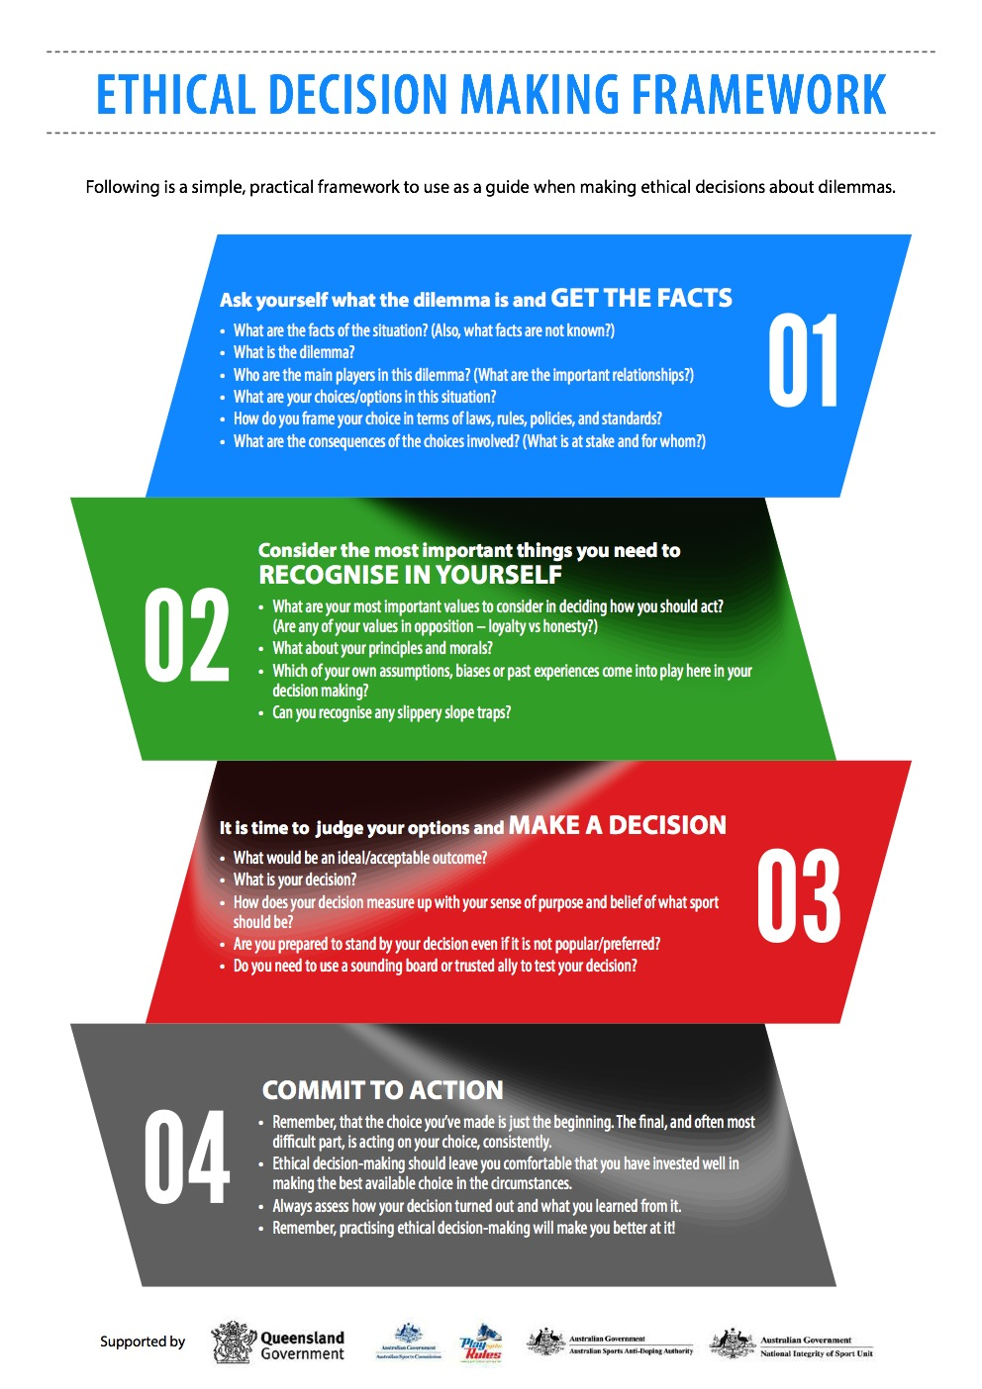
Notes:
Ethical decision making is a process that involves building awareness of ‘ethical content’ such as values, principles and beliefs about your defining purpose and an understanding of your own morals to guide your choices and actions.
It is something that involves reflection on what the dilemma is, knowing your biases, stereotypes, assumptions, making a judgment and then actioning your decision.
And it requires practice to get good at it.
We have developed this framework to assist you to work through tricky ethical dilemmas in a clear, practical way. Now let’s use it on some dilemmas!

Slide 29
‘what to do?’
ETHICAL DilemMA activities
Notes:
Now the fun begins . . .
We’re going to invite three people to form a panel on stage to work through a relevant ‘What to do? ethical dilemma. You’ll be confronted with a situation, where right and wrong isn’t so clear in which you’ll need to evaluate, discuss, debate and decide their own course of action.
We’ll chat about what is at stake and for whom, the consequences, the values that underpin their choices and how this relates to what the purpose of sport is to them, plus reflection on the assumptions and biases that may affect the choices that are made.
For the wider group, you can get involved and reflect with the panel on their answers.
Make sure to follow using your Ethical decision-making framework - as a guide to step through the dilemma-solving process.

Slide 30

SPORTSMANSHIP OR GAMESMANSHIP?
https://www.youtube.com/watch?v=LC-H2wXK4T4 (play video 0-2:00)

Slide 31
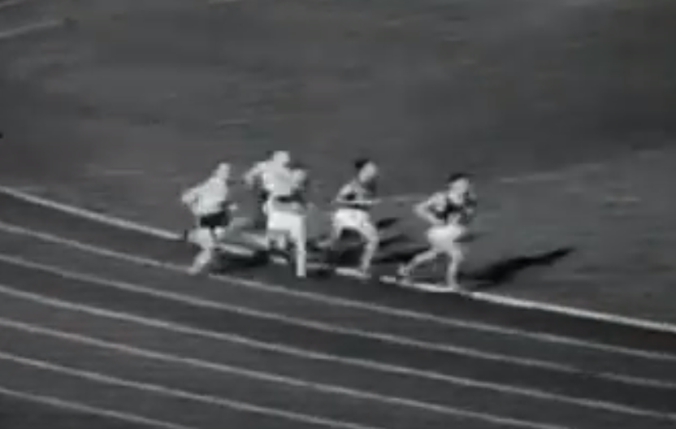
CHAMPION ATHLETE OR CHAMPION PERSON?
http://www.youtube.com/watch?v=4LZK5YbJkYQ (play video 0-1:38)

Slide 32
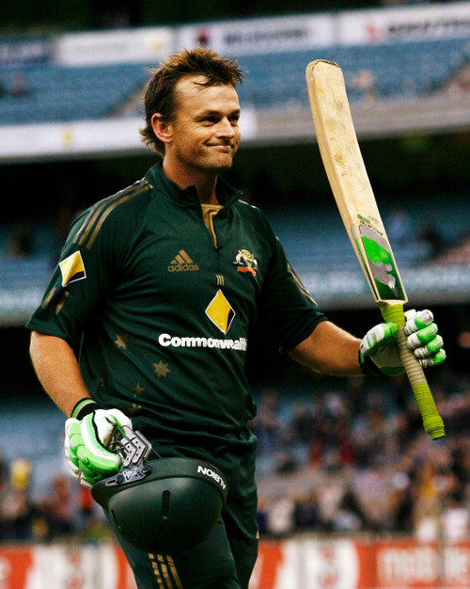
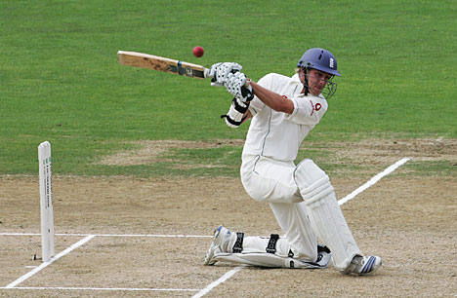
DUTY TO YOURSELF, YOUR TEAM, OR YOUR SPORT?
http://www.youtube.com/watch?v=jXYbWIi8u7E and http://www.youtube.com/watch?v=aHhZb-cBKwc (play both videos)

Slide 33
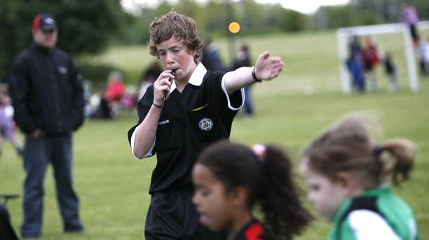
HELP OR HINDERANCE?
http://www.youtube.com/watch?v=Sdy3SwwUWDY&sns=em (play video 0:00-1:40)

Slide 34
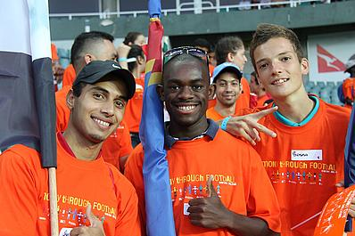
VOICING YOUR VALUES

Slide 35
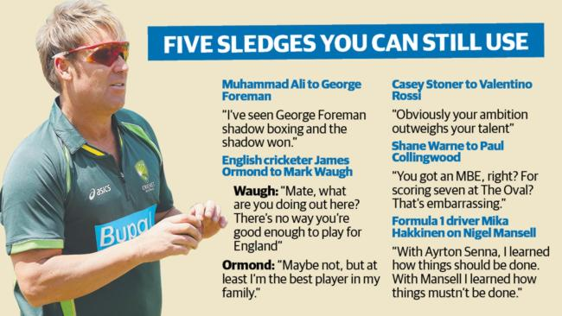
WORDS THAT WOUND

Slide 36

SUPPORTING OR EXPLOITING SPORT?

Slide 37
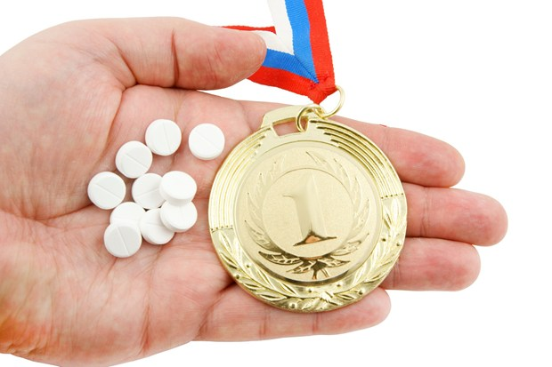
REPORT, HELP OR IGNORE?

Slide 38
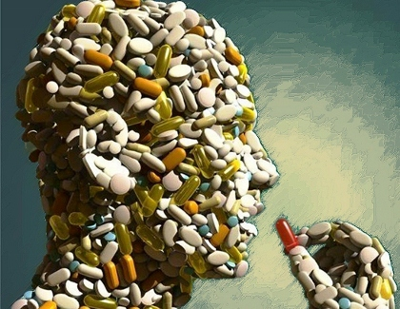
IF YOU DON’T TAKE IT YOU WON’T MAKE ITwww.outsideonline.com/outdoor-adventure/the-current/inside-outside/Lance-Armstrong-Yes-I-Feel-Like-I-Won-Those-Races.html (play video 0:00-2:11)

Slide 39
NAVIGATING THE PARTY SCENE

Slide 40

UNDER PRESSURE

Slide 41


WHERE TO DRAW THE LINE?

Slide 42
THE SLIPPERY SLOPE WITH SUPPLEMENTS
https://www.youtube.com/watch?v=WTN7JX93RsQ (play 0:00-00:55)

Slide 43

DEATH OR GLORY?

Slide 44

IT’S NOT BANNED, SO WHAT’S THE ISSUE?

Slide 45
SUMMARY
What are the main things you will take away from today’s workshop?
What things will you ‘take forward’ and do in your daily/sporting lives?
A range of resources, links and contacts have been assembled and are provided in Appendix 4.
Post workshop survey – please complete.
Thank you . . .
Notes:
One of the main goals today was to help you become more comfortable with what ethics and ethical decision-making is, so that you can utilise this information and the framework in practical situations in your lives.
There is not always an ideal answer or decision that leaves you completely comfortable once you have worked through a dilemma and the execution of that decision won’t necessarily be easy or palatable for you or others either.
What ethical decision making does do is leave you comfortable that you have invested well in making the best available choice in the circumstances. Hopefully you have had a small sample of that today through our ‘What to do?’ ethical dilemma activities.

