Slide 1
Member Protection Information Officer Program Overview presentation
Instructions for presenters
The purpose of this presentation is to provide a general overview about the Member Protection Information Officer (MPIO) role.
It is intended to be used by community sporting clubs and associations to help them provide information to people considering becoming an MPIO.
The notes sections of each slide contains links to further resources that could accompany this presentation, or for the audience to explore further.
This presentation can be adjusted to suit the specific needs of the audience or required formats, however the content must be accurate and ensure it aligns to Play by the Rules’ Member Protection Information Officers | pbtr.
If a more accessible version of this presentation is required, please email: playbytherules@sportintegrity.gov.au.

Slide 2


Member Protection Information Officer (MPIO) Program
Overview
Firstname Surname

Slide 3


Member Protection Information Officer (MPIO)
What is an MPIO?
MPIOs are there to listen to issues raised by members of any sport before triaging and referring them to the right place to find a resolution or outcome.
The MPIO is responsible for providing information about a person’s;
rights and responsibilities
options to an individual making a complaint or raising a concern, as well as
information support during the process
MPIOs do not handle complaints or investigate grievances.
Notes:
Presenters might like to show the video ‘The Importance of MPIOs’ found on the Play by the Rules website: https://www.playbytherules.net.au/mpio

Slide 4


Member Protection Information Officer (MPIO)
What an MPIO can do:
Listen
Act as an impartial support person
Provide information about discrimination, harassment and child abuse
Provide information about the Member Protection Policy and the options available to resolve the complaint
Provide information about relevant laws and the right to complain externally
Discuss possible strategies the individual can use to deal directly with the other person
Provide contact details for counselling or other referrals as appropriate or as requested
Notes:
Presenters can refer to the Play by the Rules Resource – What is an MPIO? P250710_MPIOWHAISANMPI.pdf

Slide 5
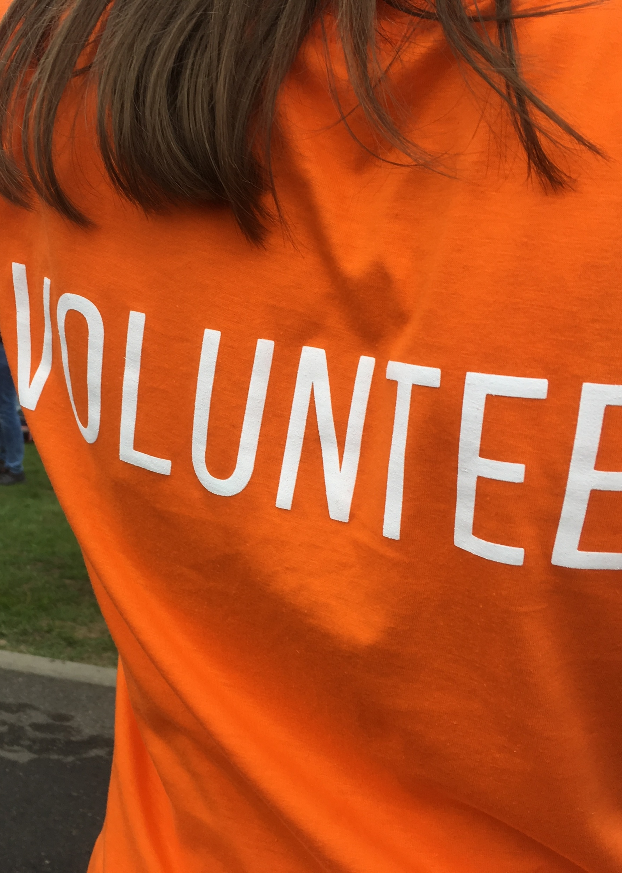

Member Protection Information Officer (MPIO)
What an MPIO can’t do:
• Advocate
• Take sides or judge
• Give legal advice
• Intervene in a complaint resolution process
• Investigate complaints
• Breach confidentiality
Notes:
Presenters can refer to the Play by the Rules Resource – What is an MPIO? P250710_MPIOWHAISANMPI.pdf

Slide 6


Member Protection Information Officer (MPIO)
MPIO Training
Part 1 – Online Module
A free, self-paced online course through Sport Integrity Australia’s online learning portal – SIA EDGE. This must be completed before attending Part 2 of the training.
Part 2 – Workshop (face-to-face or face-to-screen)
This is a workshop is facilitated by the local state or territory departments of sport and recreation, peak body for sport, state sporting organisation, National Sporting Organisation or National Sporting Organisation for People with Disability.
The MPIO Program is administered by Play by the Rules and is completed in 2 parts.
Notes:
For more information about the MPIO program, and how to gain certification, visit the Play by the Rules Website https://www.playbytherules.net.au/mpio.
Information about specific state or territory training programs and dates can be found on the Play by the Rules website at Member Protection Information Officers | pbtr
The SIA EDGE website address is: https://elearning.sportintegrity.gov.au/user_login

Slide 7
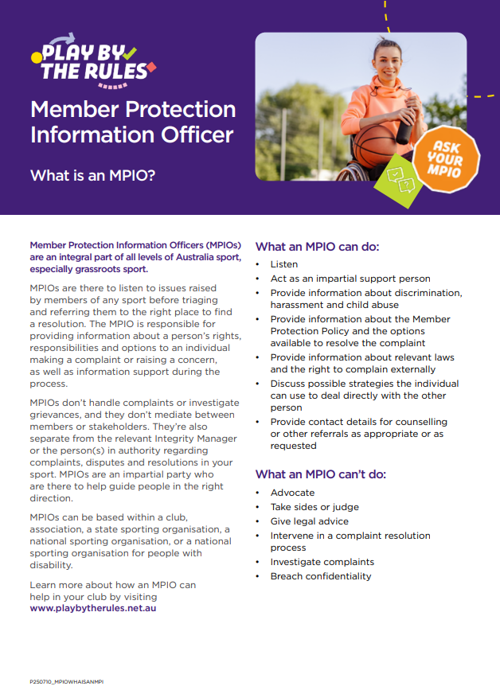
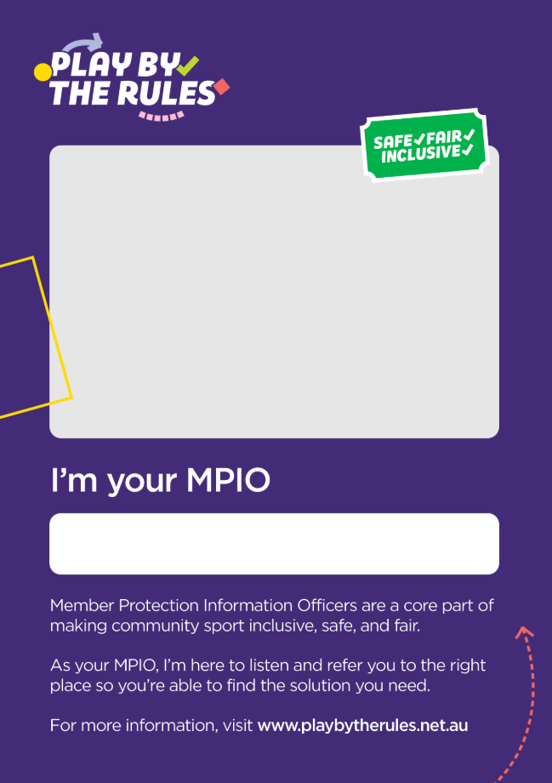
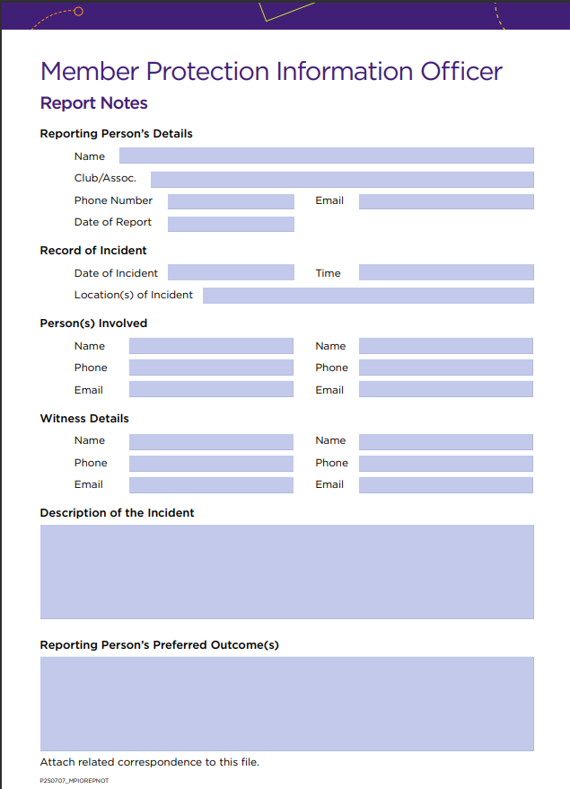
Resources
Play by the Rules has a number of resources to help MPIOs in their role.
Notes:
The Play by the Rules resources can be found on https://www.playbytherules.net.au/mpio.

Slide 8


More information
For more information about the MPIO program, visit https://www.playbytherules.net.au
Notes:
The Play by the Rules resources can be found on https://www.playbytherules.net.au/mpio.

